Slide 1


Samantha Matthews
January 13, 2024

Slide 2

Outline
Executive Summary
Introduction
Methodology
Results
Conclusion
Appendix

Slide 3
Executive Summary
Summary of Methodologies
Data Collection via API
Data Collection via Web Scraping
Data Wrangling
Exploratory Data Analysis with SQL
Exploratory Data Analysis with Data Visualization
Interactive Visual Analytics with Folium
Machine Learning Prediction
Summary of All Results
Exploratory Data Analysis Result
Interactive Analysis in Screenshots
Predictive Analysis Result from Machine Learning Lab

Slide 4
Introduction
Project Background and Context
SpaceX’s approach to space travel has disrupted the space industry by enabling lower-cost rocket launches, mostly due to its rockets’ reusable first stage that produces a large cost savings. This project’s goal is to create a machine learning pipeline that can predict the landing outcome of the first stage. This will help our employer, a startup competing with SpaceX, know what bid they should offer against SpaceX.
Problems to Solve
What variables influence the landing outcome?
What is the relationship between variables?
What are the optimal conditions for a successful landing?

Slide 5

Section 1

Slide 6
Methodology
Executive Summary
Data collection methodology:
The data was collected via the SpaceX REST API and web scraping from Wikipedia.
Perform data wrangling
The data was processed via one-hot encoding for categorical features.
Perform exploratory data analysis (EDA) using visualization and SQL
Perform interactive visual analytics using Folium and Plotly Dash
Perform predictive analysis using classification models
How to build, tune, evaluate classification models

Slide 7
Data Collection
The data sets were collected via the REST API and web scraping from Wikipedia.
For the REST API, the get request was used, and then the response was decoded as Json and converted to a Pandas dataframe using json_normalize(). Then the data was cleaned and reviewed for missing values.
For web scraping, BeautifulSoup was used to pull out the launch records as an HTML table, parse the table, and convert it to a Pandas dataframe for further analysis.

Slide 8
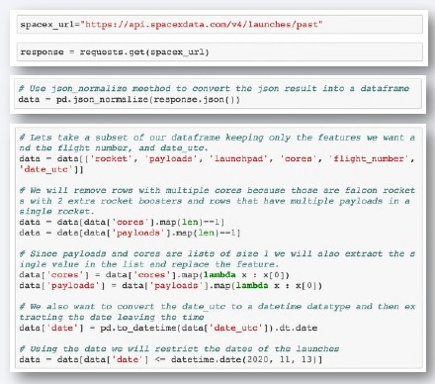
Data Collection – SpaceX API
Used API to get request for rocket launch data -> Converted json result to dataframe using json_normalize -> Cleaned data and filled in the missing values
Add the GitHub URL of the completed SpaceX API calls notebook (must include completed code cell and outcome cell), as an external reference and peer-review purpose
Place your flowchart of SpaceX API calls here

Slide 9
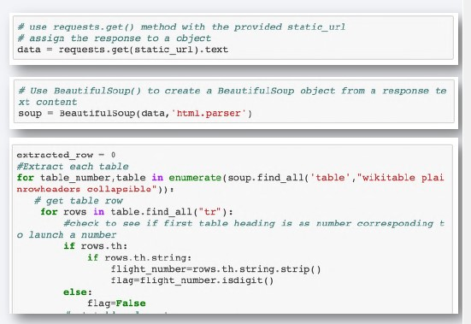
Data Collection - Scraping
Requested the URL of the Falcon 9 launch page -> Created a BeautifulSoup using the HTML result -> Extracted the columns and variable names from the HTML header
Add the GitHub URL of the completed web scraping notebook, as an external reference and peer-review purpose
Place your flowchart of web scraping here

Slide 10
Data Wrangling
The data were wrangled by calculating the number of launches at each site and then determining the number and result of mission outcomes for each orbit type.
The mission outcomes enabled us to make an outcome label to aid in further data analysis/visualization and machine learning. The results can be exported to a CSV file.
Add the GitHub URL of your completed data wrangling related notebooks, as an external reference and peer-review purpose

Slide 11
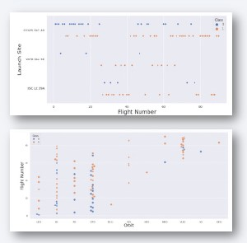
EDA with Data Visualization
The scatter plot was used to see the relationships among attributes so that we could determine which variables had the most effect on mission outcomes. Attributes included:
Flight Number
Payload
Launch Site
Orbit Type
Add the GitHub URL of your completed EDA with data visualization notebook, as an external reference and peer-review purpose

Slide 12
EDA with SQL
We performed SQL queries to examine the data set, such as
Outputting the names of the launch sites
Outputting payload masses
Outputting numbers of failed and successful mission outcomes
Outputting the different booster versions
Ranking mission success outcomes between 6/4/2010 and 3/20/2017
Add the GitHub URL of your completed EDA with SQL notebook, as an external reference and peer-review purpose

Slide 13
Build an Interactive Map with Folium
Lat/long coordinates were taken from each launch site and marked with a circle and name label for each launch site.
The dataframe launch_outcomes(failure, success) with classes 0 and 1 was assigned to red and green map markers with MarkerCluster().
Haversine’s formula was used to find the distance between the launch sites and nearby landmarks.
Add the GitHub URL of your completed interactive map with Folium map, as an external reference and peer-review purpose

Slide 14
Build a Dashboard with Plotly Dash
Plotly Dash let us further examine the data set with various graphs.
Pie charts were used to display the number of launches at various sites, and a scatter graph displayed the relationship between Payload Mass and Outcome for various booster versions.
Add the GitHub URL of your completed Plotly Dash lab, as an external reference and peer-review purpose

Slide 15
Predictive Analysis (Classification)
Build the Model: Dataset was loaded into Numpy and Pandas -> Data was transformed and split into training and test sets -> ML type was selected -> GridSearchCV was used for parameters and algorithms and fitted to a data set
Evaluate the Model: Accuracy was checked for each model -> Hyperparameters were tuned for each algorithm -> Confusion matrix was plotted
Improve the Model: Feature engineering and algorithm tuning were deployed
Find the Best Model: Determine which model has the best accuracy and use that one
Add the GitHub URL of your completed predictive analysis lab, as an external reference and peer-review purpose

Slide 16
Results
Exploratory data analysis results
Interactive analytics demo in screenshots
Predictive analysis results

Slide 17

Section 2

Slide 18
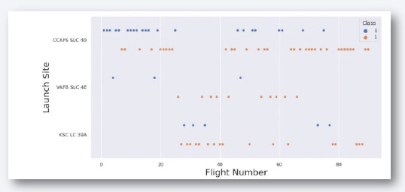
Flight Number vs. Launch Site
Launch sites with the highest number of flights also have the highest mission success rate.

Slide 19
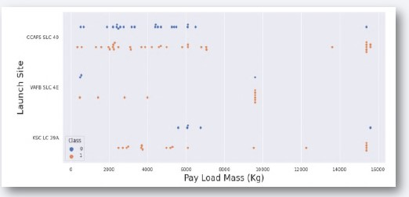
Payload vs. Launch Site
Mission success rate is higher when the payload mass is over 7000 kg.

Slide 20
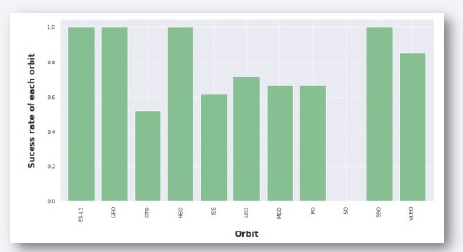
Success Rate vs. Orbit Type
Some orbits have higher mission success rates than others. While further analysis is needed, at present SSO, HEO, GEO, and ES-L1 orbits have the highest success rate.

Slide 21
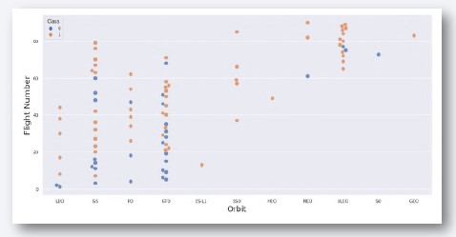
Flight Number vs. Orbit Type
As with launch sites, the orbits with the highest flight numbers also have the highest mission success rates overall (with the exception of GTO orbit).

Slide 22
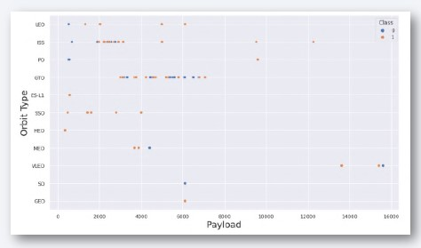
Payload vs. Orbit Type
For LEO, ISS, and PO orbits, heavier payloads have higher success rates. For MEO and VLEO orbits, heavier payloads have lower success rates.

Slide 23
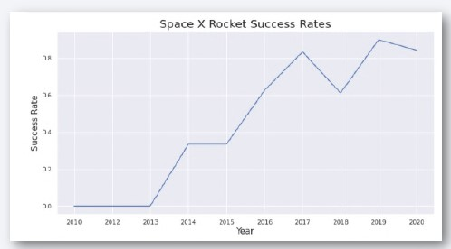
Launch Success Yearly Trend
From 2013 to 2020, the success rate trend increased.

Slide 24
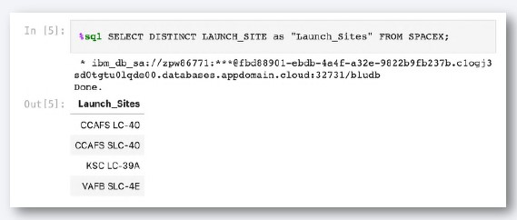
All Launch Site Names
The keyword DISTINCT was used to show only unique launch sites in the data set.

Slide 25
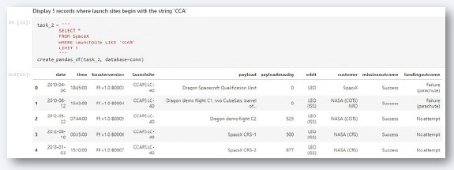
Launch Site Names Begin with 'CCA'
We displayed 5 records where launch sites begin with `CCA`

Slide 26
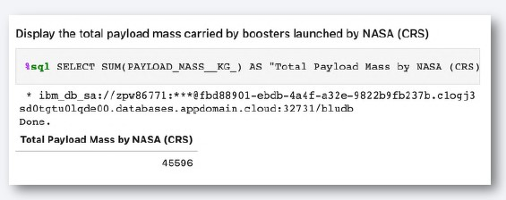
Total Payload Mass
The total payload carried by NASA boosters was found and displayed.

Slide 27
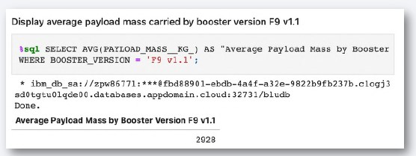
Average Payload Mass by F9 v1.1
The average payload mass carried by booster version F9 v1.1 was calculated and displayed.

Slide 28
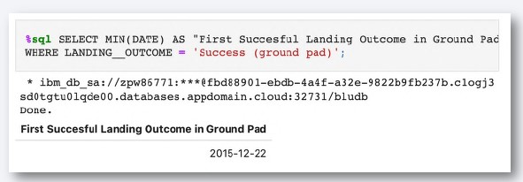
First Successful Ground Landing Date
The min() function was used to find the first successful landing outcome on the ground pad: December 22nd, 2015.

Slide 29
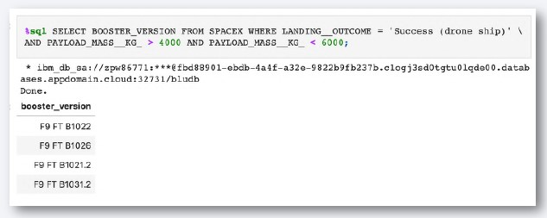
Successful Drone Ship Landing with Payload between 4000 and 6000
The WHERE and AND clauses were used to list the names of boosters which have successfully landed on a drone ship and had payload masses greater than 4000 but less than 6000 kg.

Slide 30
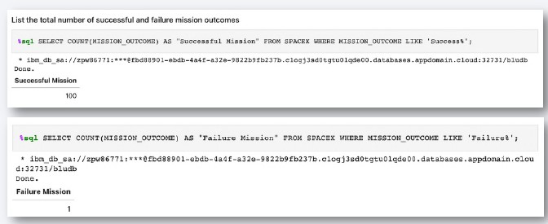
Total Number of Successful and Failure Mission Outcomes
Wildcard operators like ‘%’ were used to filter for WHERE the mission outcomes were either successful or failures

Slide 31
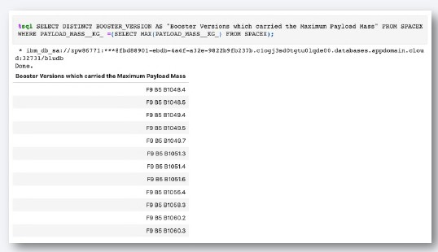
Boosters Carried Maximum Payload
Boosters that carried the maximum payload masses were listed using WHERE and max().

Slide 32
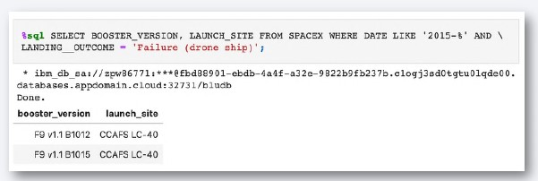
2015 Launch Records
The WHERE clause and the LIKE, AND, and BETWEEN conditions were used to find the failed landing_outcomes in drone ships, their booster versions, and launch site names for the year 2015.

Slide 33
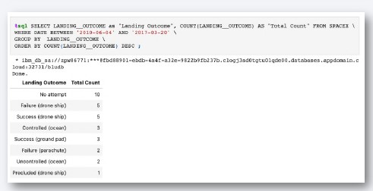
Rank Landing Outcomes Between 2010-06-04 and 2017-03-20
COUNT, WHERE, BETWEEN, GROUP BY, and ORDER BY were used to rank the counts of landing outcomes (such as Failure (drone ship) or Success (ground pad)) between the dates 2010-06-04 and 2017-03-20, in descending order.

Slide 34

Section 3

Slide 35
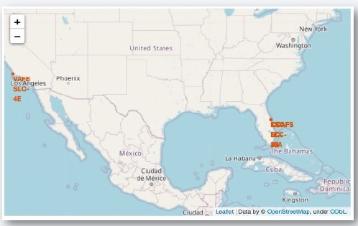
Launch Site Locations
All launch sites are within the contiguous United States.

Slide 36
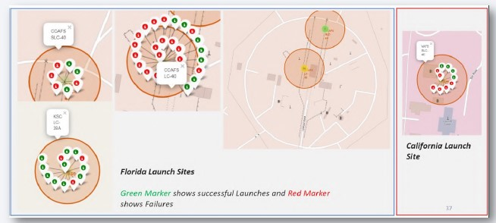
Launch Site Markers and Labels

Slide 37
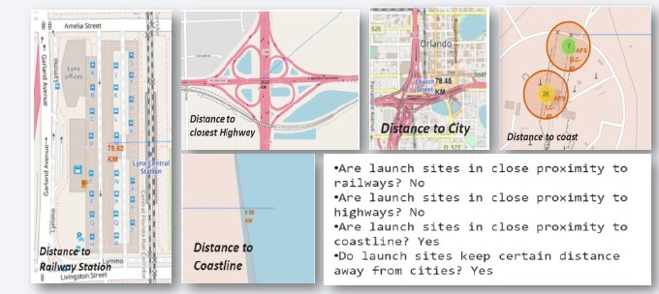
Distances Between Launch Sites and Landmarks

Slide 38

Section 4

Slide 39
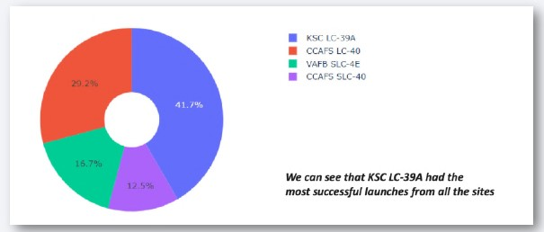
Launch Site Mission Success Rates

Slide 40
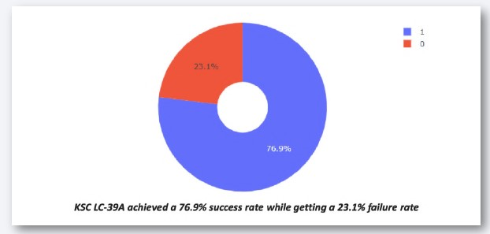
Launch Success Ratios

Slide 41
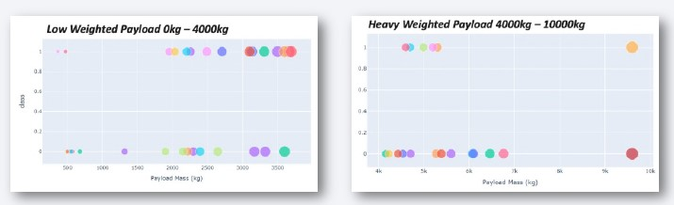
Payload vs. Launch Outcomes
Lower payload weights had higher success rates than higher-weight payloads.

Slide 42

Section 5

Slide 43
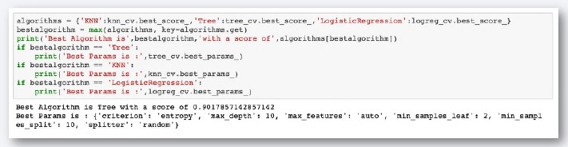
Classification Accuracy
The tree algorithm showed the highest classification accuracy.

Slide 44
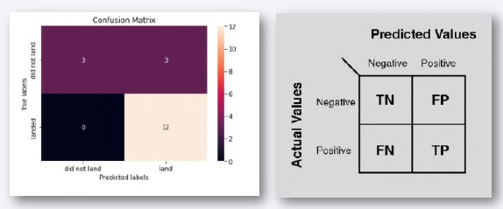
Confusion Matrix
The decision tree classifier can tell the difference among the different classes, but it does sometimes show false positives.

Slide 45
Conclusions
Payloads below 4000 kg had higher mission success rates than heavier payloads.
Since 2013, the mission success rate continued increasing until 2020, and the trend indicates further increase after 2020.
For launch sites, KSC LC-39A had the highest mission success rate at 76.9%.
For orbits, SSO orbit had the highest mission success rate at 100% for multiple launches.
The tree classifier algorithm was the best ML approach for this data set.

Slide 46


